Slide 1

Standard of living
LI : Differences in living standards and the meaning of living standards
SC: Definition of standard of living and causes of differences

Slide 2
Defining standard of living
Standard of living shows the quality of life lived by individuals. It often refers to the affordability of necessities, comforts, and luxuries purchased by individuals to enhance their well-being.
It aims to improve the overall quality of life for individuals and societies by providing access to basic needs, such as food, shelter, healthcare, and education, as well as opportunities for personal and economic growth.

Slide 3
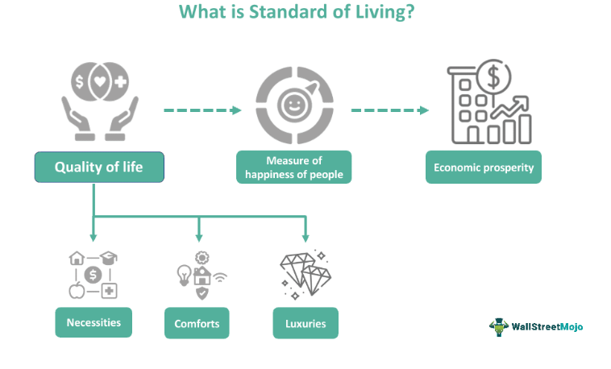

Slide 4
https://www.gapminder.org/dollar-street

